Slide 1
What is Web Service
A web service is a software module that is intended to carry out a specific set of functions.
A web service is a standardized method for propagating messages between client and server applications.
A Web services can be invoked by client over the network.
The web service would be able to deliver functionality to the client that invoked the web service.
A web service is a set of open protocols and standards that allow data to be exchanged between different applications or systems.
Web services can be used by software programs written in a variety of programming languages and running on a variety of platforms to exchange data via computer networks
Any software, application, or cloud technology that uses standardized web protocols (HTTP or HTTPS) to connect, interoperate, and exchange data messages – commonly XML (Extensible Markup Language) and JSON – across the internet is considered a web service.
A client invokes a web service by submitting an XML/JSON request, which the service responds with an XML/JSON response.

Slide 2
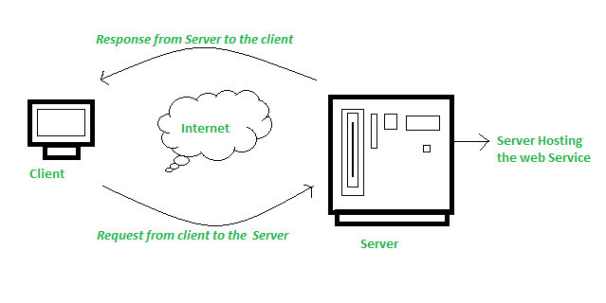
How Does Web Service Work?
The diagram depicts a very simplified version of how a web service would function. The client would use requests to send a sequence of web service calls to a server that would host the actual web service.

Slide 3
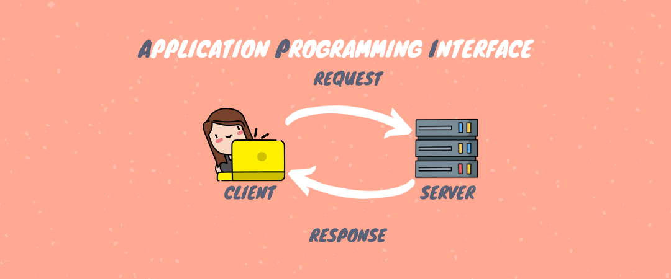
What is Web API
API stands for Application Programming Interfaces (APIs).
Application Programming Interfaces (APIs) are basically HTTP services that are used to communicate between applications in a simple and easy way.
Web API is an API as the name suggests, it can be accessed over the web using the HTTP protocol.
It is a framework that helps you to create and develop HTTP based RESTFUL services.

Slide 4
Web API
API stands for Application Programming Interface which allows software applications to communicate with each other via API calls.
Web API is a framework that makes it easy to build or crate HTTP services
API services reach a broad range of clients, including browsers and mobile devices.
This is the new framework for building HTTP services with easy and simple way.
The ASP.NET Web API is an ideal platform for building REST Services on the .NET Core/Framework.
Web API services can be consumed by a broad range of clients like 1. Browsers 2. Mobile applications 3. Desktop applications 4. IOTs( Internet Of Things)
It can be hosted with in IIS/Tomcat or Windows Azure
It is very similar to ASP.NET MVC since it contains the MVC features such as routing, controllers, action results, filter, model binders etc.
Notes:
What are IOTs The term IOTs stands for Internet Of Things. Internet Of Things are the objects or devices that have an IP address and can communicate over the internet with other internet enabled devices and objects. Examples for IoT include security systems, electronic appliances, thermostats, cars etc..., in addition to desktops, laptops, and smart phones.

Slide 5
Service Types
Web Service
It is based on SOAP and return data in XML form.
It support only HTTP protocol.
It is not open source but can be consumed by any client that understands xml.
It can be hosted only on IIS.
WCF
It is also based on SOAP and return data in XML form.
It is the evolution of the web service(ASMX) and support various protocols like TCP, HTTP, HTTPS, Named Pipes, MSMQ.
The main issue with WCF is, its tedious and extensive configuration.
It is not open source but can be consumed by any client that understands xml.
It can be hosted with in the applicaion or on IIS or using window service.

Slide 6
Service Types
Web API
This is the new framework for building HTTP services with easy and simple way.
Web API is open source an ideal platform for building REST-full services over the .NET Core/Framework.
it use the full features of HTTP (like URIs, request/response headers, caching, versioning, various content formats)
It also supports the MVC features such as routing, controllers, action results, filter, model binders, IOC container or dependency injection, unit testing that makes it more simple and robust.
It can be hosted with in the application or on IIS/Azure/AWS.
It is light weight architecture and good for devices which have limited bandwidth like smart phones.
Responses are formatted by Web API’s MediaTypeFormatter into JSON, XML or whatever format you want to add as a MediaTypeFormatter.

Slide 7
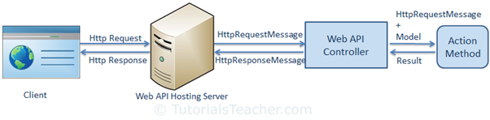
request/response pipeline

Slide 8
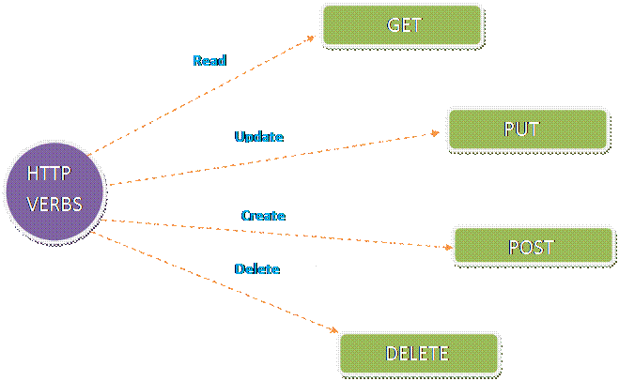
HTTP Verbs in ASP.NET Core Web API
One of the key features of HTTP is the use of verbs (also known as methods or actions) to perform specific operations on resources.
In the context of ASP.NET Web API, these HTTP verbs are used to create, read, update, and delete data.
The following are the five most commonly used HTTP verbs in the ASP.NET Core Web API
Get
Post
Put
Delete
Patch

Slide 9
HTTP GET
This verb is used to retrieve data from the server.
It is a read-only operation that does not change any data on the server.
A GET request is used to retrieve a representation of a resource from the server.
Example:
The following endpoint retrieves a list of all employees.
GET /api/Employee/ListEmployees

Slide 10
HTTP POST
This verb is used to create new data on the server.
It is a write operation that adds a new resource to the server.
A POST request is used to submit an entity to the specified resource, often causing a change in state on the server.
Example:
The following endpoint create or add the employee.
POST /api/Employee/CreateEmployee .

Slide 11
HTTP PUT
This verb is used to update existing data on the server.
It is a write operation that replaces an existing resource with a new one.
A PUT request is used to update a resource with the client-provided data.
Example:
The following endpoint updates employee with ID 1.
PUT /api/Employee/updateEmployee/1 .

Slide 12
HTTP DELETE
This verb is used to delete data on the server.
It is a write operation that removes a resource from the server.
A DELETE request is used to delete a resource identified by a URI.
Example:
The following endpoint deletes employee with ID 1.
DELETE /api/Employee/deleteEmloyee/1.

Slide 13
HTTP PATCH
This verb is used to update partial data on the server.
It is a write operation that modifies a portion of an existing resource.
A PATCH request is used to update a resource with only the specific changes provided in the request body.
Example:
The following endpoint updates a specific property of employee with ID 1.
PATCH /api/Employee/partialupdate/1

Slide 14
Selecting The Appropriate Method
A large portion of application functionality can be summed up in the acronym CRUD, which stands for Create, Read, Update, Delete. There are four HTTP methods that correspond to these actions, one for each, like so:
C - Create - POST
R - Read - GET
U - Update - PUT
D - Delete - DELETE

Slide 15
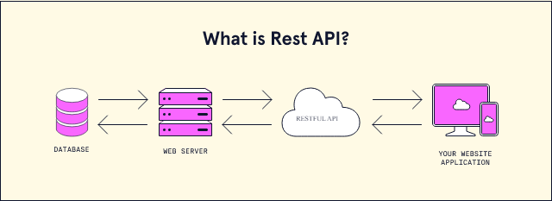
What is REST
REST stands for Representational State Transfer
Representational State Transfer (REST) is an architectural style that defines a set of constraints to be used for creating web services.
The web services that follows the REST architectural style is called RESTful Web Services.

Slide 16
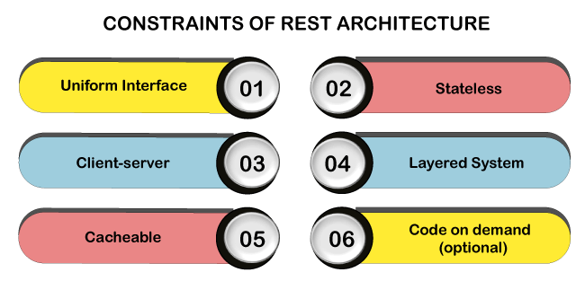
What is REST
The REST architectural style describes the six constraints.

Slide 17
Constraints for RESTful Architecture
Client-Server
The client-server design pattern enforces the separation of concerns, which helps the client and the server components evolve independently.
By separating the user interface concerns (client) from the data storage concerns (server), we improve the portability of the user interface across multiple platforms and improve scalability by simplifying the server components.
While the client and the server evolve, we have to make sure that the interface/contract between the client and the server does not break.
Notes:
What are IOTs The term IOTs stands for Internet Of Things. Internet Of Things are the objects or devices that have an IP address and can communicate over the internet with other internet enabled devices and objects. Examples for IoT include security systems, electronic appliances, thermostats, cars etc..., in addition to desktops, laptops, and smart phones.

Slide 18
Constraints for RESTful Architecture
Stateless
Statelessness mandates that each request from the client to the server must contain all of the information necessary to understand and complete the request.
The server cannot take advantage of any previously stored context information on the server.
Notes:
What are IOTs The term IOTs stands for Internet Of Things. Internet Of Things are the objects or devices that have an IP address and can communicate over the internet with other internet enabled devices and objects. Examples for IoT include security systems, electronic appliances, thermostats, cars etc..., in addition to desktops, laptops, and smart phones.

Slide 19
Constraints for RESTful Architecture
Cacheable
The cacheable constraint requires that a response should implicitly or explicitly label itself as cacheable or non-cacheable.
If the response is cacheable, the client application gets the right to reuse the response data later for equivalent requests and a specified period.
Notes:
What are IOTs The term IOTs stands for Internet Of Things. Internet Of Things are the objects or devices that have an IP address and can communicate over the internet with other internet enabled devices and objects. Examples for IoT include security systems, electronic appliances, thermostats, cars etc..., in addition to desktops, laptops, and smart phones.

Slide 20
Constraints for RESTful Architecture
Layered System
The layered system style allows an architecture to be composed of hierarchical layers by constraining component behavior.
For example, in a layered system, each component cannot see beyond the immediate layer they are interacting with.
Code on Demand (Optional)
REST also allows client functionality to extend by downloading and executing code in the form of applets or scripts.
The downloaded code simplifies clients by reducing the number of features required to be pre-implemented. Servers can provide part of features delivered to the client in the form of code, and the client only needs to execute the code.
Notes:
What are IOTs The term IOTs stands for Internet Of Things. Internet Of Things are the objects or devices that have an IP address and can communicate over the internet with other internet enabled devices and objects. Examples for IoT include security systems, electronic appliances, thermostats, cars etc..., in addition to desktops, laptops, and smart phones.

Slide 21
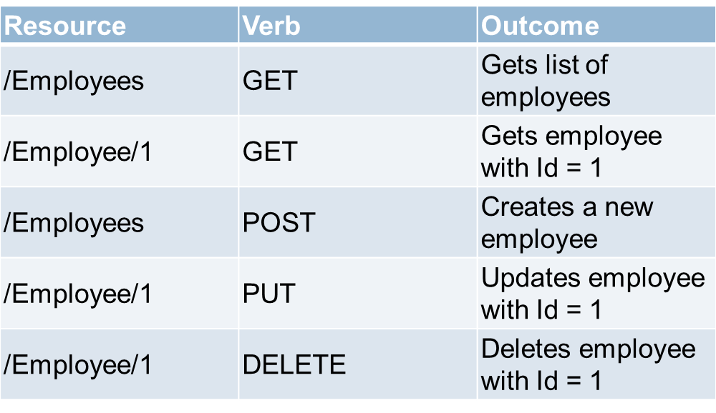
Constraints for RESTful Architecture
Uniform Interface - The uniform interface constraint defines the interface between the client and the server. To understand the uniform interface constraint, we need to understand what a resource is and the HTTP verbs - GET, PUT, POST & DELETE. In the context of a REST API, resources typically represent data entities. Product, Employee, Customer etc are all resources. The HTTP verb (GET, PUT, POST, DELETE) that is sent with each request tells the API what to do with the resource. Each resource is identified by a specific URI (Uniform Resource Identifier). The following table shows some typical requests that you see in an API
Notes:
What are IOTs The term IOTs stands for Internet Of Things. Internet Of Things are the objects or devices that have an IP address and can communicate over the internet with other internet enabled devices and objects. Examples for IoT include security systems, electronic appliances, thermostats, cars etc..., in addition to desktops, laptops, and smart phones.

Slide 22
What is a Resource?
The key abstraction of information in REST is a resource.
Any information that we can name can be a resource. For example, a REST resource can be a document or image or a non-virtual object (e.g., a person).
Notes:
What are IOTs The term IOTs stands for Internet Of Things. Internet Of Things are the objects or devices that have an IP address and can communicate over the internet with other internet enabled devices and objects. Examples for IoT include security systems, electronic appliances, thermostats, cars etc..., in addition to desktops, laptops, and smart phones.

